Slide 1
Deep Learning based hourly based load fore casting of a residential zonal area in Mumbai
Course project
Advanced Machine Learning (CS726)
Presented by:
Bharat Bohara
Roll No: 173172001
Date of Submission: 7th May, 2018

Slide 2
Introduction
More than 60 –70 % of energy is consumed daily on heating and cooling load in residential as well as industrial sectors
Efficient energy consumption by minimizing excessive energy waste
Intelligent distribution as well as consumption of energy at the end usage level
Intelligent decision making of how to use the energy primarily requires accurate prediction of the future energy loads and demands

Slide 3
Introduction
Previously due to lack of higher computational power, the conventional methods of foresting were not powerful enough to fill up the gap of the mismatch between original and predicted forecasts.
These days along with the higher computation achievement and innovations in new forecasting methodology based on deep neural networks, specially Long Short Term Memory (LSTM) algorithms have proved to be the promising techniques in predicting the future outcomes more accurately

Slide 4
Methodology
90 % of the historical data of power consumption in one of the location in Thane, Mumbai has been taken to train LSTM based sequence to sequence (S2S) neural networks architecture
Remaining 10 % of the fetched data has been used for the validation of the designed deep neural network based model.
Throughout the whole project, Keras library along with Tensorflow as blackened has been used.
Finally, the trained model is further used to predict the future electric load demands for the next few months.

Slide 5
Results and Conclusion
Dataset of electricity consumption for an aggregated residential and industrial load of entire ocation of Thane circle, Bhandup zonal region was taken to train the model.
The data set contained power consumption measurements gathered between July 2017 to December 2017 with one-hour resolution from 11 KV feeder outgoing recored by Maharashtra state electricity distribution Co. Ltd.
The LSTM architecture was tested on one-hour resolution simply bypassing the input from the current step straight to the output, this is because consequent measurements are very similar.
The network predicts that the load for the next time step is the same as that the load on the current time.
Thus, the neural network is learning a naive mapping, where it generates an output equal to the input.
In order to improve accuracy on testing data dropout (=0.2) has been used used as regularization.

Slide 6
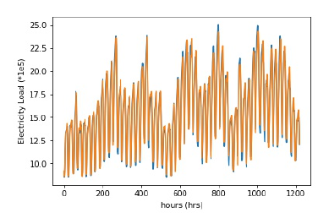
Results and Conclusion
LSTM network used for the future load predictions.

Slide 7
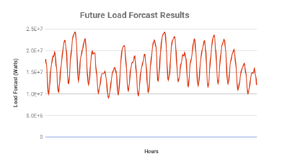
Results and Conclusion
LSTM network used for the future Future Forecast Results obtained from the Trained LSTM Model predictions

Slide 8
Conclusion
The goal of this course project was to observe the effectiveness in using LSTM based deep neural networks for building level energy load forecasting.
Further, regularization approaches was applied to improve the generalization of the models.
For the easy computation and scrutinizing the whole project ,libraries like Keras along with Tensorflow were used.
The results of the trained model was very close the original values which showed that deep learning based LSTM algorithms can be used for forcasting any time series datasets.
From this project, conceptual insight behind the deep learning especially sequential recurrent network (LSTM, GRU etc) were learnt

